Slide 1

Data Engineering
Capstone Project THIERRY JOEL MELI TCHIN DA
691 | 218 494517601 | 5148 133
Notes:
Bring Example about metadata

Slide 2
Project Title and Description
Clod
Security
COVID-19 Pandemic: Determine the factors influencing COVID-19 deaths 2020-2023
Analyze the data to find the conditions contributing to COVID-19 deaths by state and age for the years 2020-2023.
Gather relevant datasets including information on COVID-19 deaths, underlying health conditions, conditions groups, age groups, and geographic locations(states).

Slide 3
Project Scope
Clod
Security
Define the scope of your project
and most importantly, the things you will not do (out of scope)
In the Scope
Out of Scope
Analysis covid-19 deaths 2020-2023
Analysis per state
Analysis the state with the highest death rates
Analysis the most common contributing condition
Analysis the most vulnerable age group
Name of deacesed
Analysis per condition
Date of death
Analysis the rates in every city by state
Analysis per gender
Analysis in the world

Slide 4
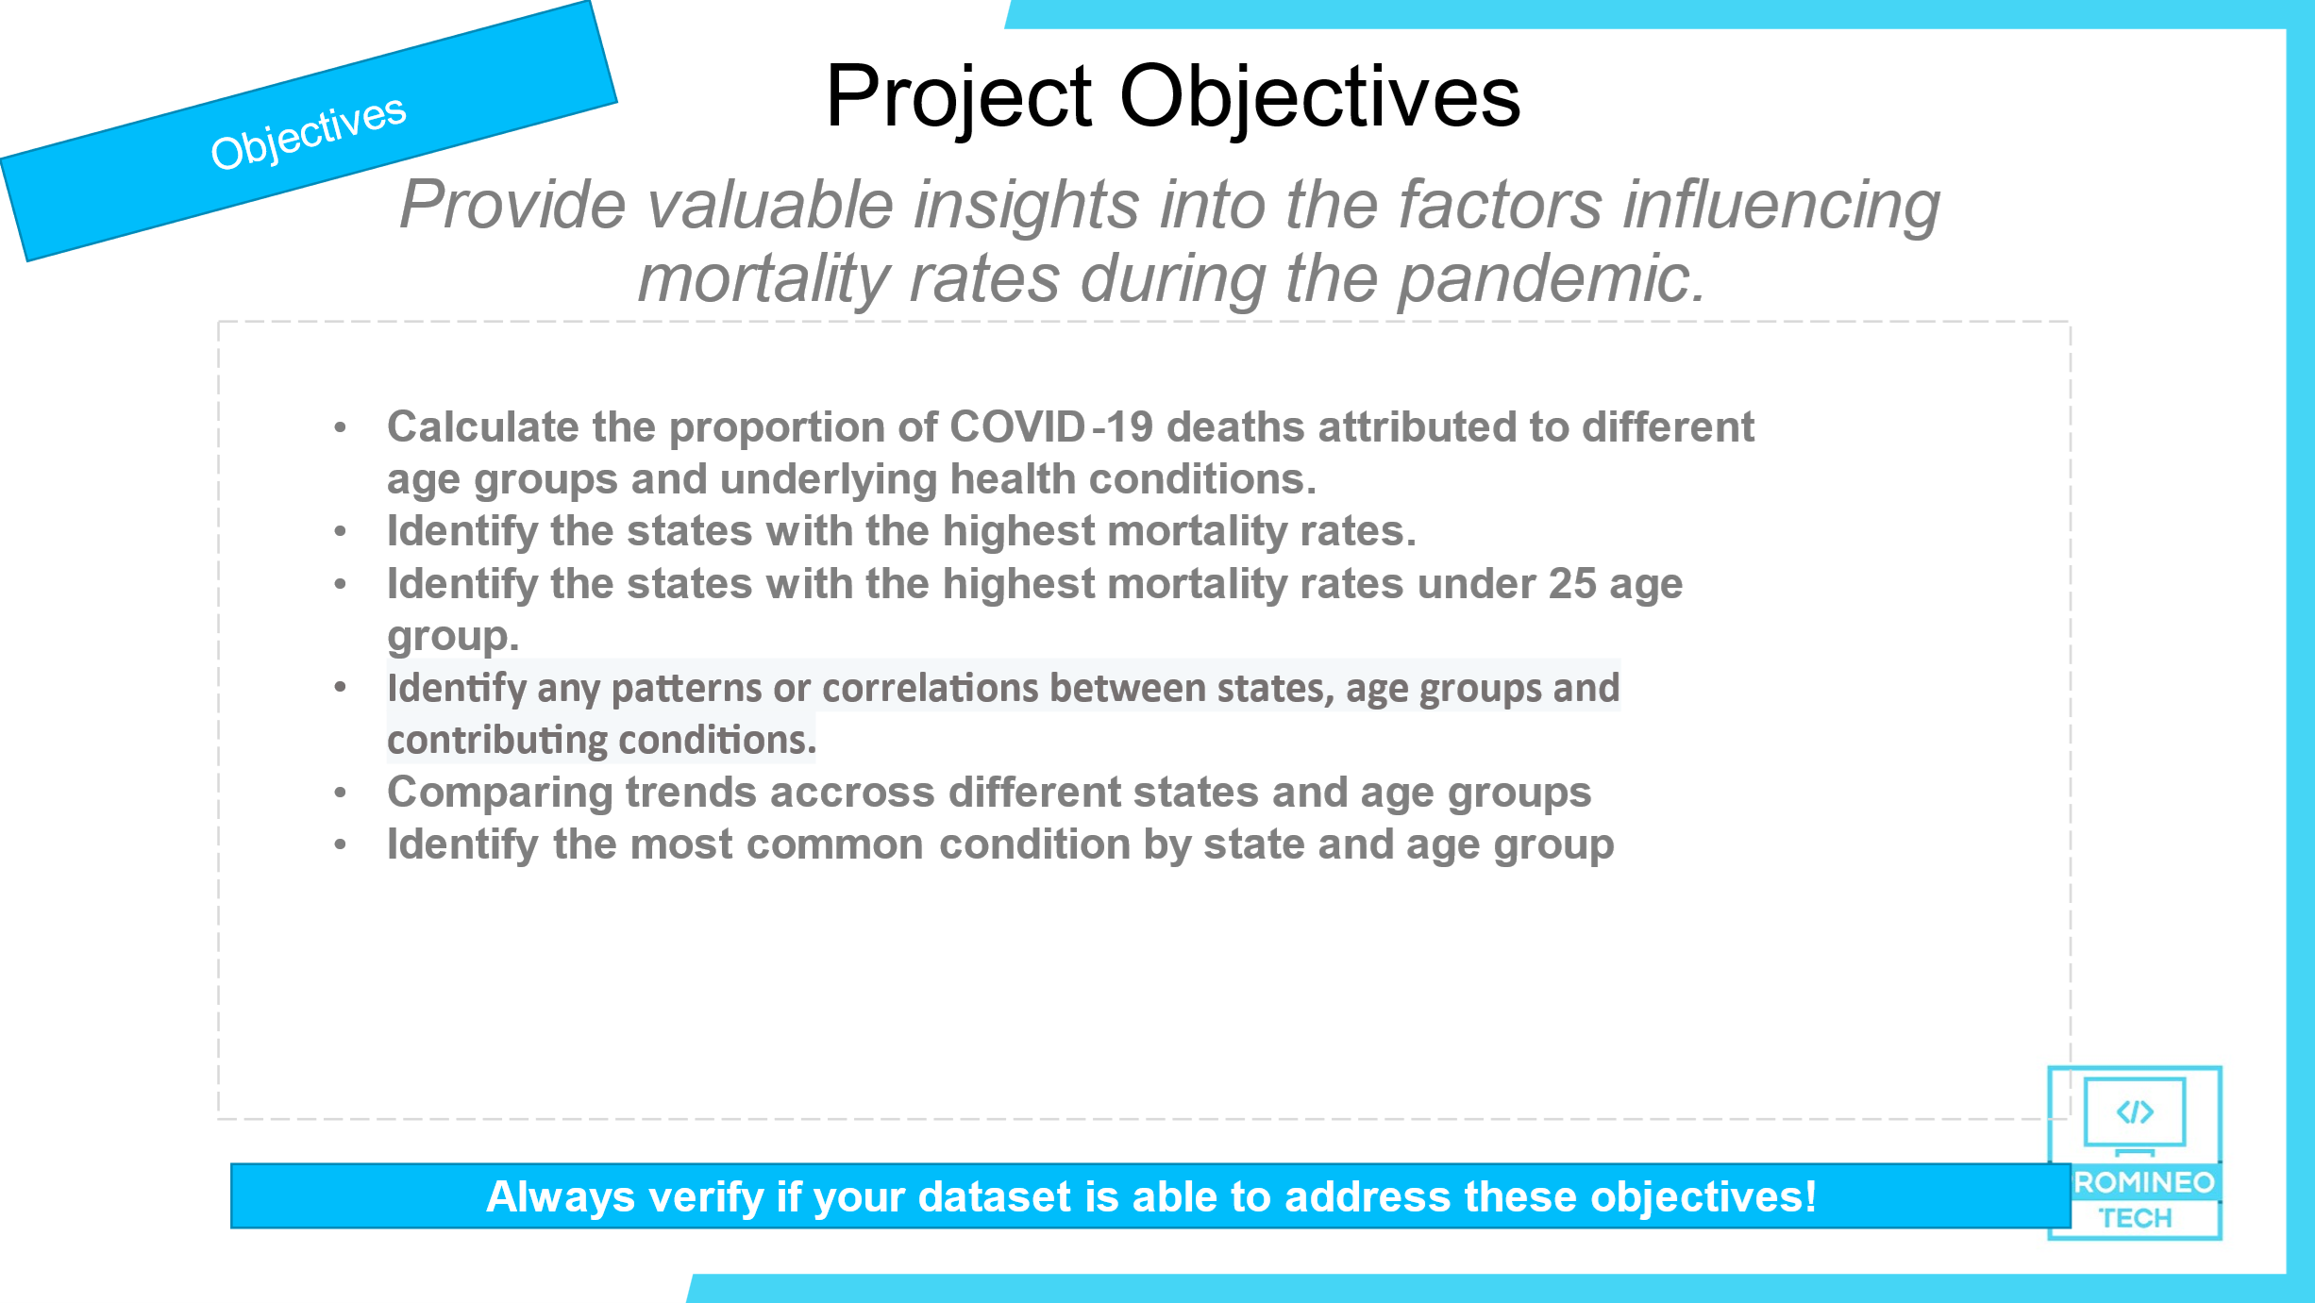

Slide 5







Build an HLD – High Level Design
Your HLD should contain the technical stack you`ll use to build your project
Application
Clod
Security
Local
Cloud
Local
Data ingestion
In Batch
S3
Lake Formation
Redshift
1
AWS Glue

Slide 6
Clod
Security
Thank you!

